Slide 1

Safe Reinforcement Learning

Slide 2
What is Reinforcement Learning?
Learning by
Interaction
Burning
Rewards
Artificial Intelligence
Machine Learning
Supervised Learning
Unsupervised Learning
Deep Learning

Slide 3
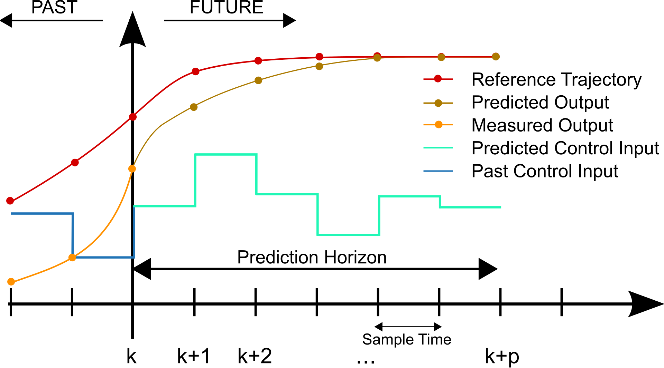
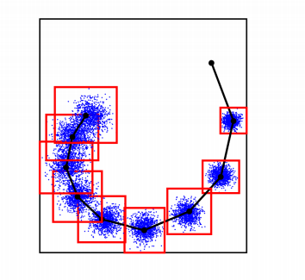
Model Predictive Control
Modelbased
Optimal
Predictable
Stable
Function approximator

Slide 4
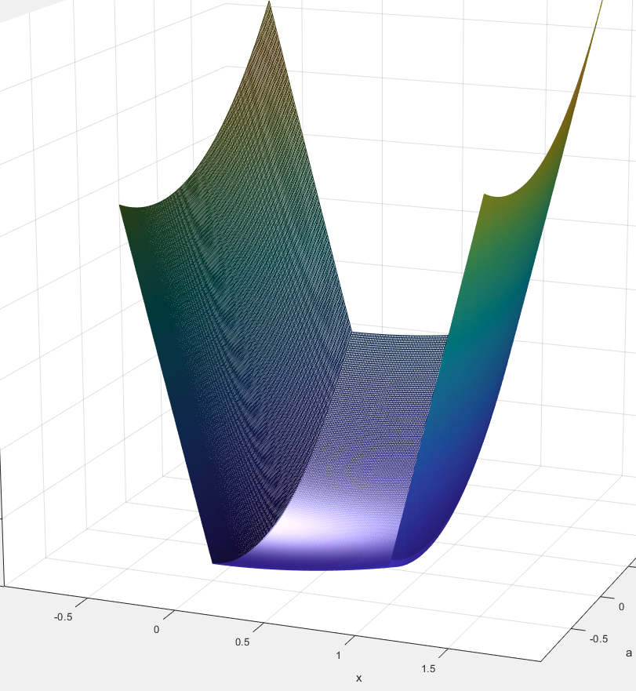
Combining the two
RL + MPC = <3
Robust MPC to ensure safety
RL to ensure maximum performance

Slide 5
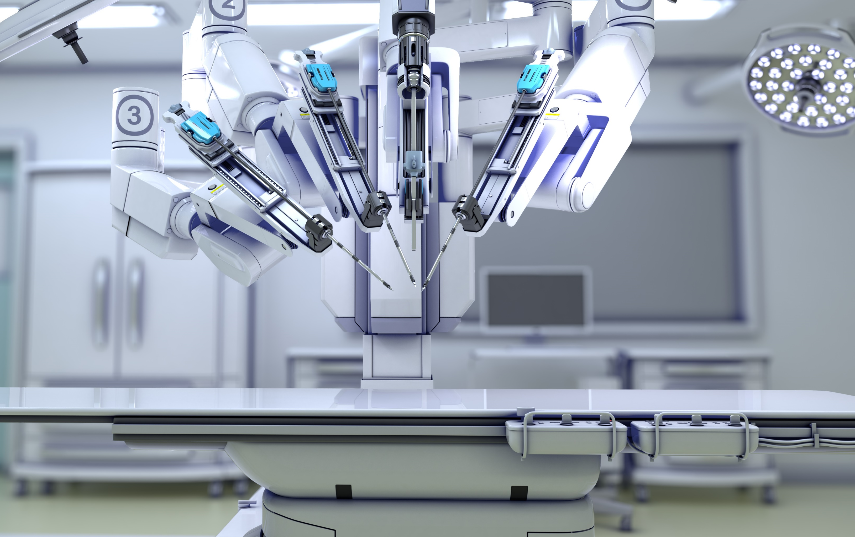

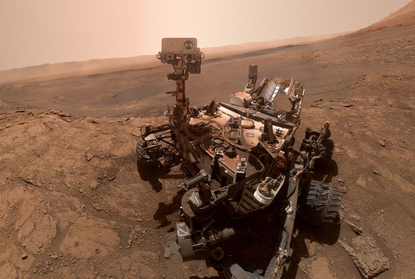
Applications
Coming to a town near you

